Slide 1
Micro-ROS
Installation

Slide 2
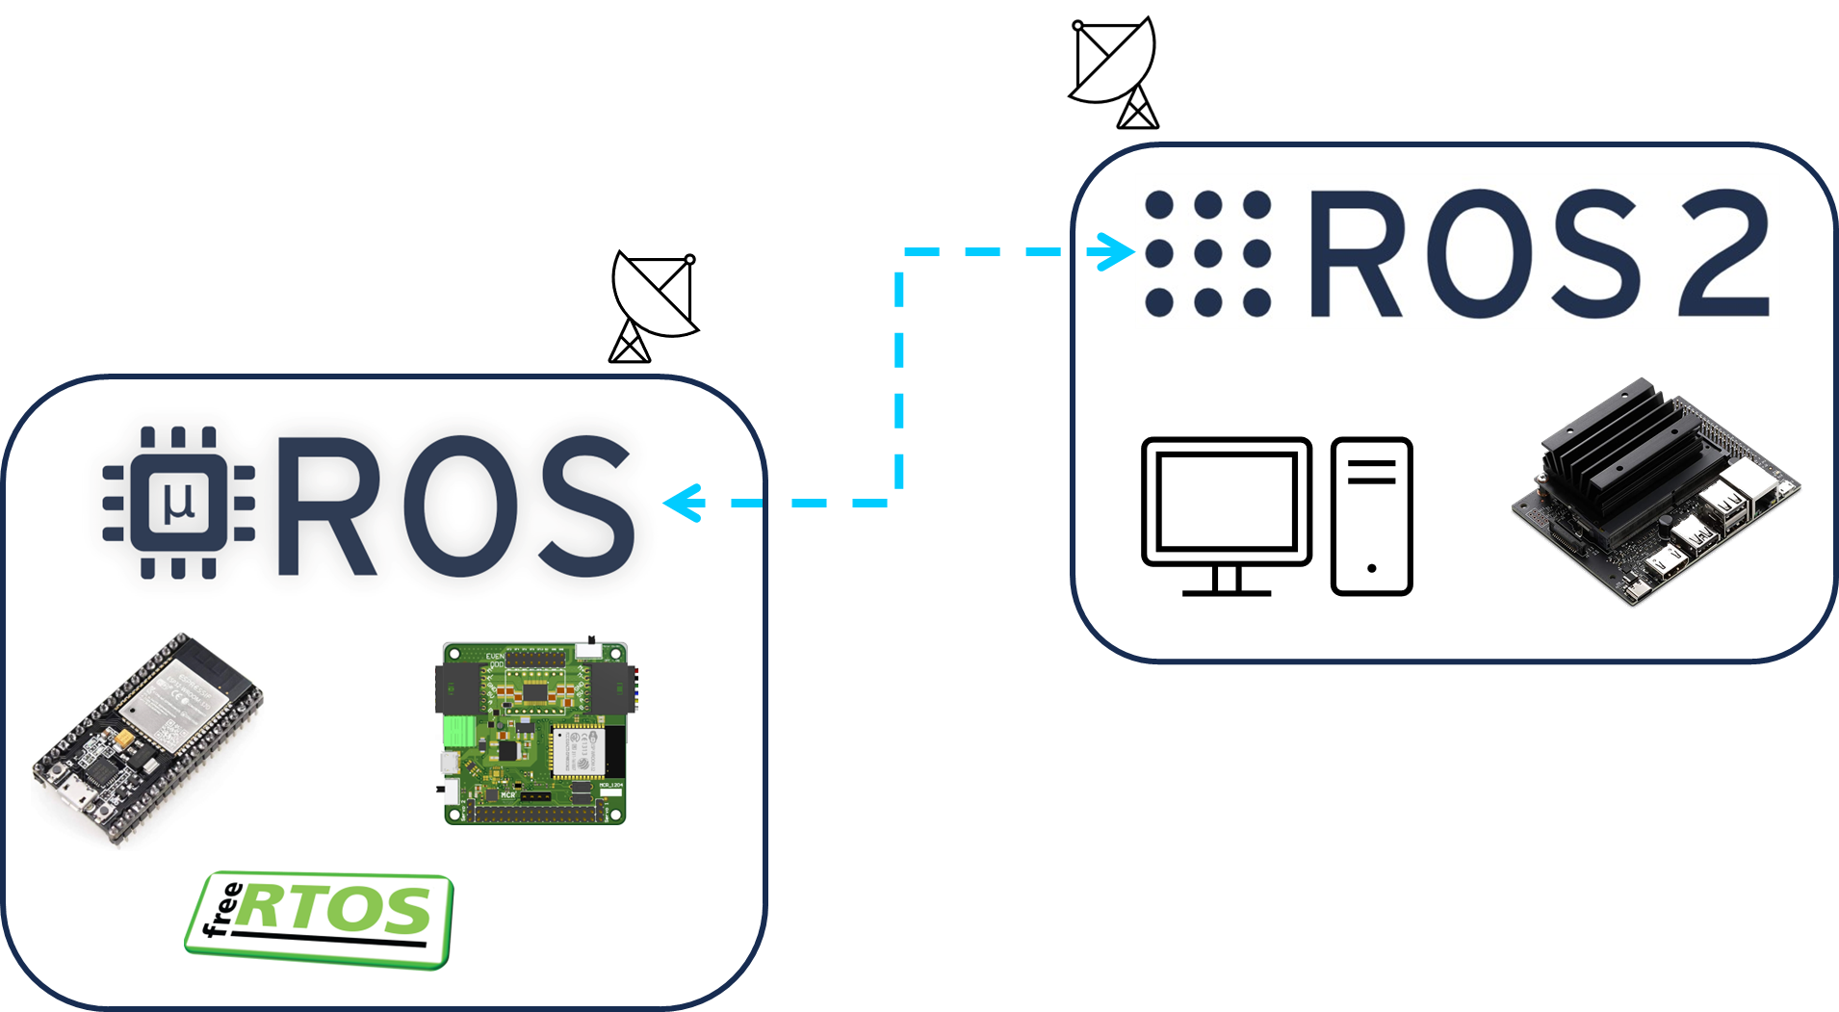
micro-ros
Micro-ros is a tool that bridges the gap between resource-constrained microcontrollers and larger processors in robotic applications that are based on the Robot Operating System.
The installation of micro-ros is divided in two parts.
Installing the “agent” on an Ubuntu-based system with ROS 2, which is the firmware in charge of communicating with the microcontroller from the computer.
Installing the microcontroller libraries required to compile the microcontroller code.
This tutorial will show how to install both libraires for Ubuntu 22.04 with ROS2 Humble.
micro-ros_arduino libraries for the Arduino IDE.
The microcontroller to be used is the ESP32 by Espressif.

Slide 3
Ubuntu
micro-ros agent installation

Slide 4
micro-ros agent installation
Create a ROS 2 workspace and build this package for ROS2 Humble
$ source /opt/ros/humble/setup.bash
$ mkdir uros_ws && cd uros_ws
$ git clone -b humble https://github.com/micro-ROS/micro_ros_setup.git src/micro_ros_setup
$ sudo apt update -y
$ sudo apt upgrade -y
$ sudo apt full-upgrade -y
$ sudo apt autoremove -y
$ sudo apt autoclean -y
$ sudo apt purge
Install and update dependencies
$ sudo rosdep init
$ rosdep update && rosdep install --from-paths src --ignore-src -y
Build package
$ sudo apt install python3-pip -y
$ colcon build
$ source install/local_setup.sh
$ ros2 run micro_ros_setup create_agent_ws.sh
$ ros2 run micro_ros_setup build_agent.sh
$ source install/local_setup.sh
$ echo "source ~/uros_ws/install/local_setup.bash" >> ~/.bashrc
Port Permissions
$ dmesg | grep tty
$ sudo chmod a+rw /dev/tty*
$ sudo usermod -a -G dialout $USER

Slide 5
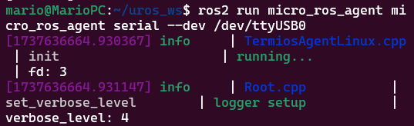
micro-ros agent installation
To test the installation, type the following.
For now, nothing is published since no microcontroller is connected to the computer.
In the next section, the instructions for installing micro-ros libraries for Arduino will be shown.
$ ros2 run micro_ros_agent micro_ros_agent serial --dev /dev/ttyUSB

Slide 6
Ubuntu
Arduino IDE Configuration

Slide 7
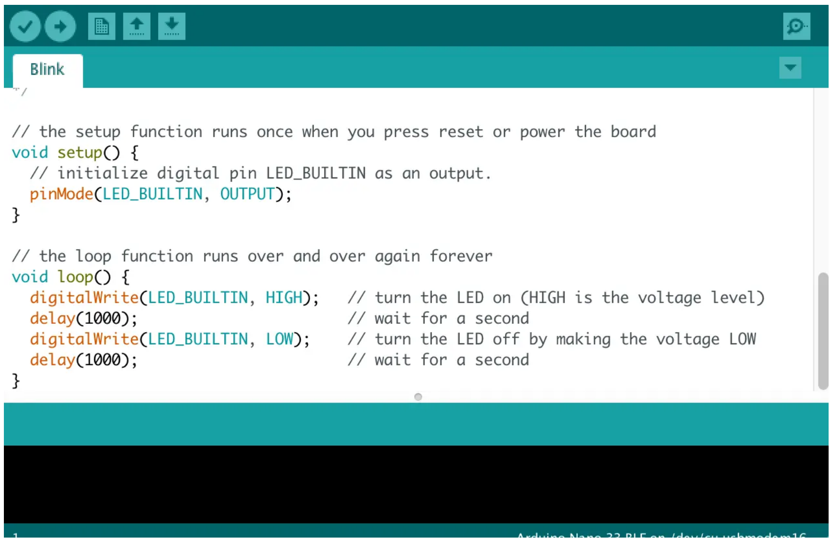
Arduino IDE
Configuring the Arduino IDE
The Arduino and Arduino IDE are great tools for quickly and easily programming hardware.
The micro_ros_arduino package, allows the usage of ROS directly with the Arduino IDE.
micro_ros_arduino provides an ROS communication protocol that works with your Arduino's UART.
micro_ros_arduino, allows Arduino to be a ROS node which can directly publish and subscribe to ROS messages, publish TF transforms, and get the ROS system time.
Arduino IDE can also be used to program the Hackerboard and other microcontrollers like the ESP32.
Arduino IDE

Slide 8
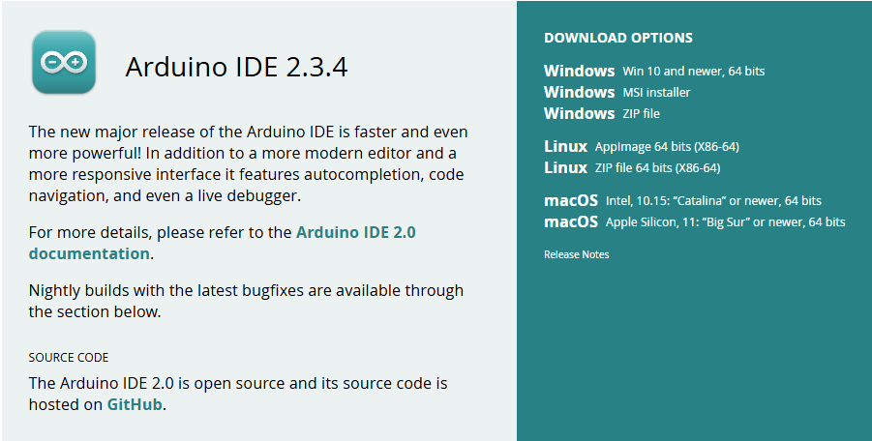
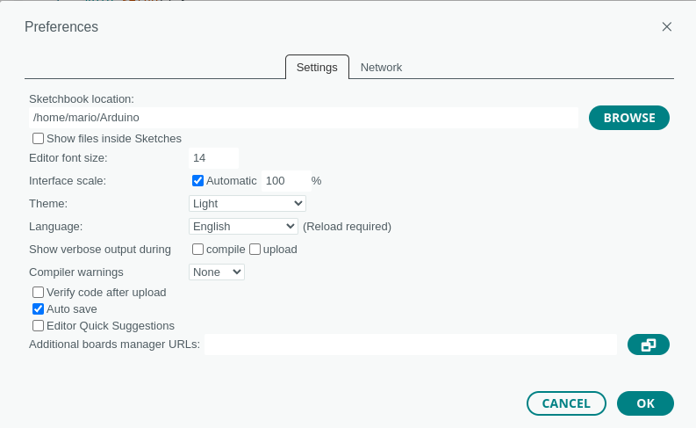
Arduino IDE
Installation
Download the Arduino IDE from the website.
Install the Arduino IDE application into a folder on the desktop (Windows), or home folder (Ubuntu).
Follow the installation instructions for Windows and Linux here.
Once installed, launch the application if you want to select your sketchbook location (File>>Preferences>>Sketchbook location).
Sketchbook is a standard place to store your programs, or sketches.
Close the IDE when done.
Note: The Arduino IDE can be installed in the Virtual Machine, following the same steps.

Slide 9
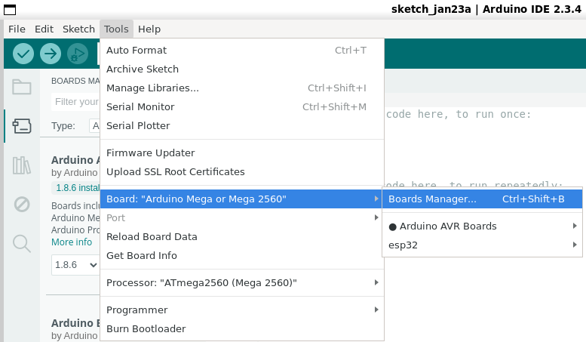
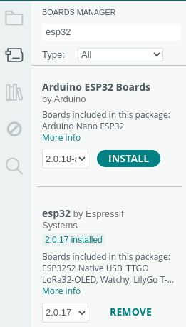
Arduino IDE-ESP32 Setup
Arduino IDE – ESP32 and Hackerboard setup
To install the ESP32 libraries simply
Open the Arduin IDE
Go to Tools>>Board>>Boards Manager
In the search bar of the left panel type “esp32”
Select the “esp32 by Espressif”
Select the version 2.0.17 NOT THE NEWEST!! IS NOT FULLY COMPATIBLE WITH MICRO-ROS!
DO NOT UPGRADE THE LIBRARY!
Press “Install”
Test the installation using the example (at the end) here or here.

Slide 10
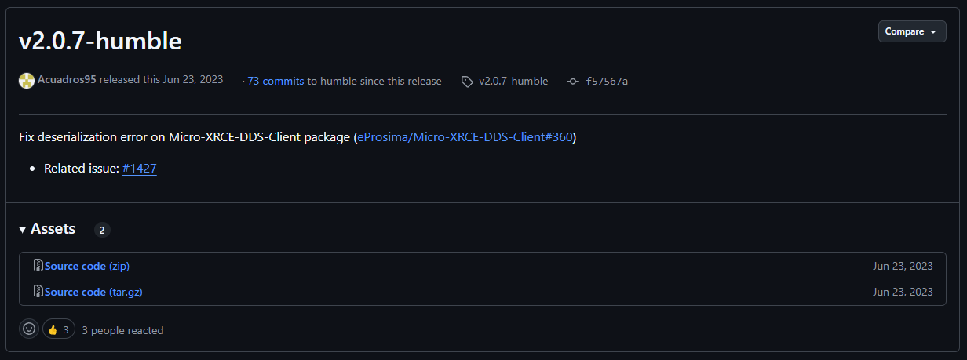
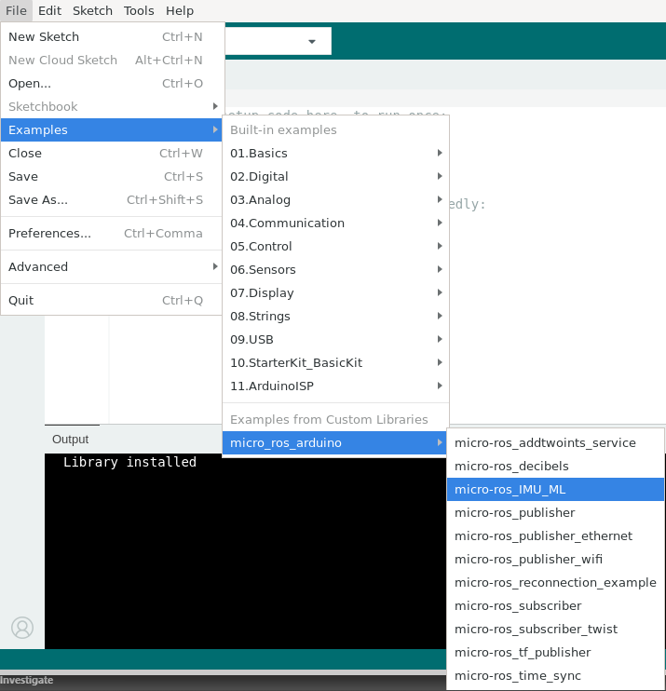
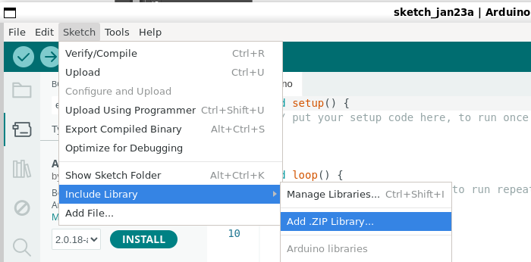
micro-ros-arduino Setup
micro-ros setup (windows/ubuntu)
Download the “micro_ros_arduino” package here
Click on the v2.07-humble version (stable)
Download “Source code.zip”
Open Arduino IDE
Go to Sketch>>Include Library>>Add .ZIP Library
Select the “micro_ros_arduino-2.0.7-humble.zip” library you downloaded in the first step.
Restart the Arduino IDE
If properly installed, you should be able to see the examples File>>Examples>micro_ros_arduino

Slide 11
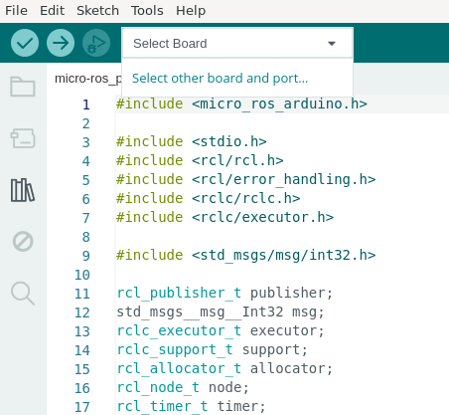
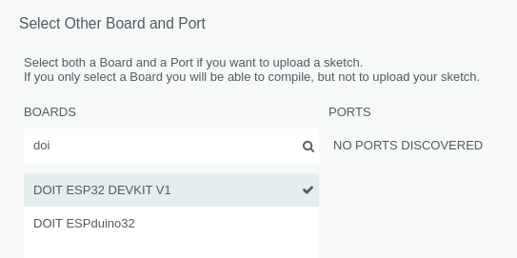
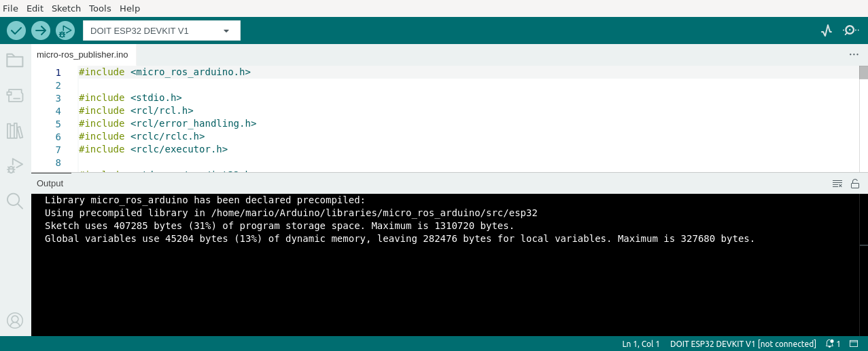
micro-ros-arduino Setup
micro-ros verification
Open the example micro-ros_publisher
Compile the example by selecting on the “Select Board” bar “DOIT ESP32 DEVKIT V1”
Click in the check mark at in the top left bar to compile.
The program should compile correctly.
If not, go to the Troubleshoot section of this presentation.

Slide 12
Port Permissions (Ubuntu)
To use Arduino or the ESP32 in Ubuntu, the user must give permissions to the system for accessing ports.
Make sure the port permissions are granted for the user.
In a new terminal type cd ~/dev to visualise the port designated by Ubuntu to the MCU. This port are usually called /ttyACM0 or /ttyUSB0.
Having obtained the name of the port type the correspondent command to enable the permissions (replace the asterisk with the port number).
To make the change permanently, follow the steps here.
sudo chmod 666 /dev/ttyACM*
sudo chmod 666 /dev/ttyUSB*

Slide 13
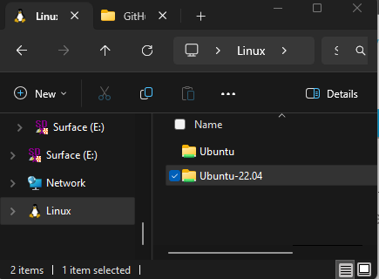
WSL (Windows Subsystem for Linux)
To install the Arduino IDE on WSL follow the next steps.
Install the Nautilus (File manager)
Download Arduino IDE Linux AppImage under Windows
Copy the file using the Windows File Explorer (open a folder) then select the file and copy it or move it to Linux
Give executable permissions and update the libraries to the file in Ubuntu
$ sudo apt install nautilus -y (Ubuntu Window)
$ sudo apt-get update && sudo apt-get upgrade
$ nautilus
(After nautilus window pop-up, close it) (Ubuntu Window)
$ chmod u+x arduino-ide_2.0.3_Linux_64bit.AppImage
$ sudo apt-get update && sudo apt-get upgrade
$ sudo apt-get install -y libgbm-dev
$ nautilus
$ Double Click AppImage File & Wait for Arduino to Download Packages
Ubuntu-22.04/home/$USER$/

Slide 14
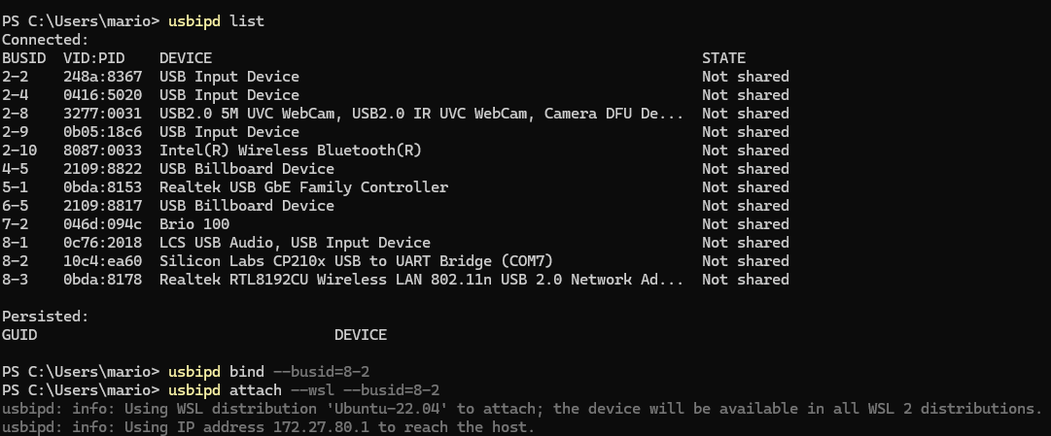
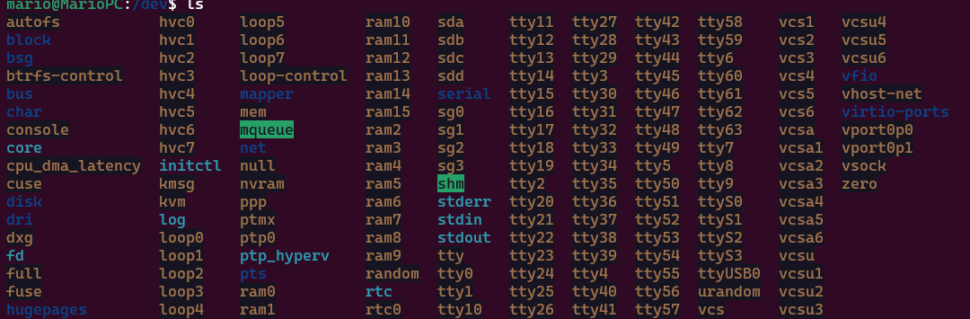
WSL (Windows Subsystem for Linux)
To access the USB Port from WSL Install the “usbipd-win” package in windows.
More information here and here.
Open a Powershell
Attach Arduino/ESP32 Board with PC through USB
Make Sure Com Port Appears in Device Manager (Windows)
Install COM port Drivers If required (Windows)
Restart Powershell and run as admin
To finish the session
winget install usbipd
In Linux, check that the port is displayed and provide port permissions as shown previously. Now, you can work as normal in WLS. Do not forget to detach at the end of the session.
$ cd /dev
$ ls
usbipd list
usbipd bind --busid=BUSID
usbipd attach --wsl --busid= BUSID
usbipd detach --busid= BUSID

Slide 15
Testing
Testing installation

Slide 16
Testing installation
Test
Open the example micro-ros_publisher on Arduino IDE
Compile and upload the example by selecting on the “Select Board” bar “DOIT ESP32 DEVKIT V1”
Click on the arrow in the top left bar to compile.
(WSL) If using WSL check how to access serial ports in the previous section.
(Ubuntu) Verify that the ports have permissions in Ubuntu.
(Windows) Verify the correct ports are selected in Windows and that the drivers are installed (troubleshoot section)
The program should compile and upload correctly.

Slide 17

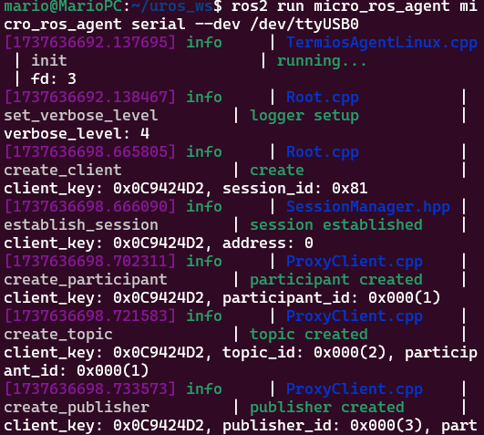
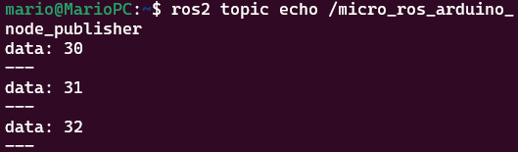
Testing installation
Test
Open another terminal and type the following.
Reset the ESP32 (pressing the reset button) to reconnect to the computer.
Open another terminal and type the following.
Echo the topic “/micro_ros_arduino_node_publisher”
$ ros2 topic list
$ ros2 run micro_ros_agent micro_ros_agent serial --dev /dev/ttyUSB0
$ ros2 topic echo /micro_ros_arduino_node_publisher

Slide 18
Troubleshoot
Common problems with Arduino IDE

Slide 19
Arduino IDE-ESP32 Setup
Troubleshoot
If the “esp32 by Espressif” is not available follow one of the next tutorials.
Simple tutorial (not official)
Simple tutorial Arduino IDE 2.0 (not official)
Espressif Tutorial (official)
Official Github
Connect the Hackerboard/ESP32 to the computer.
Test the installation using the example (at the end) here or here.

Slide 20
USB Ports in VM
When connecting a USB to a VM several steps must be performed for the virtual machine to be able to recognise the USB Port from the host computer. More information can be found here.
Make sure the correct drivers for the device are installed in the host computer. More information can be found here.
Give permissions to the VM to access the USB ports of the host machine. More information can be found here and here.
A video tutorial on how to connect USB devices to the VMWare Player can be found here.

Slide 21
Troubleshoot
Troubleshooting
When compiling for the ESP32 the following error appears
“Missing Python: “python”: executable file not found in $PATH”
To avoid this error, you can install the python-is-python3 package to create the symbolic links.
sudo apt install python-is-python3
When compiling the following error appears
“ImportError: No module named serial”
To avoid this error, install the pyserial library
sudo apt install python3-pip
pip3 install pyserial
Additional Troubleshoot can be found here, here and here.

Slide 22
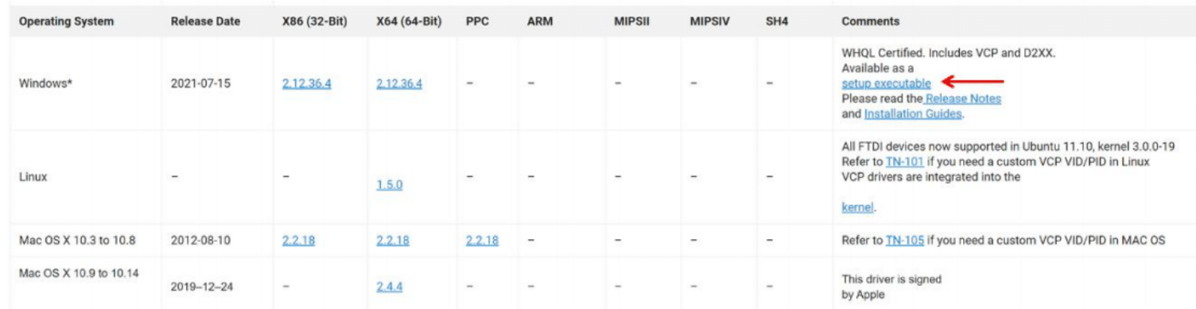

Troubleshoot
Troubleshoot (Drivers)
Drivers are usually installed automatically by Windows and Ubuntu even for the Virtual Machines.
How do I know if the drivers are properly installed (Windows)?
Plug the Puzzle-Bot into the USB port.
Go to Start > Device Manager
The Serial port should appear as shown in the following figure (The COM port may vary).
If the computer cannot find the drivers, download the drivers from the following link
https://ftdichip.com/drivers/vcp-drivers/
Verify that the USB cable is a data cable and not only a power cable!
Scroll down and download the executable setup as shown in the following figure
Before Installing the drivers!!
Unplug the Puzzle-Bot from the computer.
Unzip the drivers and run the setup (some computers are required to be restarted after the installation).
Plug the Puzzle-Bot back into the computer.

Slide 23
Troubleshoot
Troubleshoot (Drivers)
Some Hackerboards have a different USB-UART chip the CP210x.
Drivers are usually installed automatically by Windows and Ubuntu even for the Virtual Machines.
Verify if they are installed by following the steps in the previous slide.
Verify that the USB cable is a data cable and not only a power cable!.
If the computer cannot find the drivers, download the drivers from the following link
https://www.silabs.com/developers/usb-to-uart-bridge-vcp-drivers?tab=downloads
Before Installing the drivers!!
Unplug the Puzzle-Bot from the computer.
Unzip the drivers and run the setup (some computers are required to be restarted after the installation).
Plug the Puzzle-Bot back into the computer.
A troubleshoot guide can be found here.

Slide 24
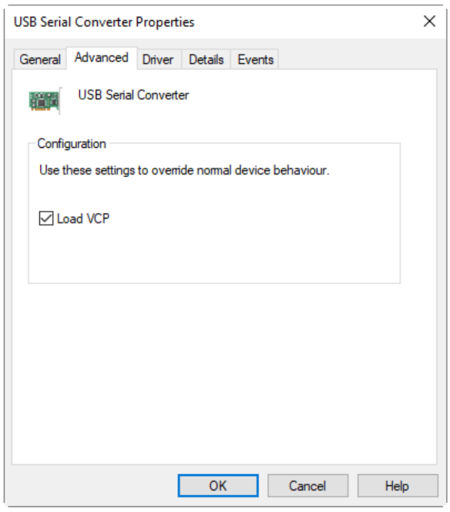
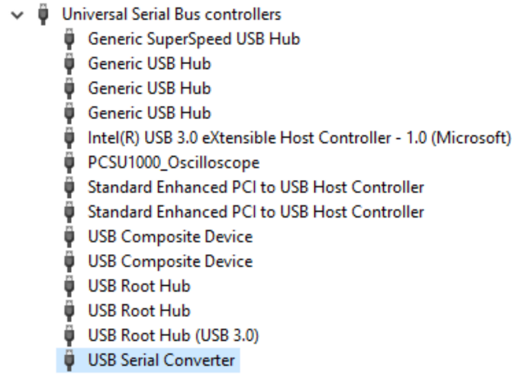
Troubleshoot
Troubleshoot (Drivers)
My computer still not recognize the drivers even after the installation
Plug the Puzzle-Bot into the USB port.
Go to Start > Device Manager.
Look for the USB Serial Converter as shown in the following picture.
Right Click to Properties > Advanced Tab.
Make sure the Load VCP box is checked.
Reconnect the Puzzle-Bot to the computer.
FIGURE: USB SERIAL CONVERTER
FIGURE: VCP PORT

Slide 25
Thank you

Slide 26
T&C
Terms and conditions

Slide 27
Terms and conditions
THE PIECES, IMAGES, VIDEOS, DOCUMENTATION, ETC. SHOWN HERE ARE FOR INFORMATIVE PURPOSES ONLY. THE DESIGN IS PROPRIETARY AND CONFIDENTIAL TO MANCHESTER ROBOTICS LTD. (MCR2). THE INFORMATION, CODE, SIMULATORS, DRAWINGS, VIDEOS PRESENTATIONS ETC. CONTAINED IN THIS PRESENTATION IS THE SOLE PROPERTY OF MANCHESTER ROBOTICS LTD. ANY REPRODUCTION, RESELL, REDISTRIBUTION OR USAGE IN PART OR AS A WHOLE WITHOUT THE WRITTEN PERMISSION OF MANCHESTER ROBOTICS LTD. IS STRICTLY PROHIBITED.
THIS PRESENTATION MAY CONTAIN LINKS TO OTHER WEBSITES OR CONTENT BELONGING TO OR ORIGINATING FROM THIRD PARTIES OR LINKS TO WEBSITES AND FEATURES IN BANNERS OR OTHER ADVERTISING. SUCH EXTERNAL LINKS ARE NOT INVESTIGATED, MONITORED, OR CHECKED FOR ACCURACY, ADEQUACY, VALIDITY, RELIABILITY, AVAILABILITY OR COMPLETENESS BY US.
WE DO NOT WARRANT, ENDORSE, GUARANTEE, OR ASSUME RESPONSIBILITY FOR THE ACCURACY OR RELIABILITY OF ANY INFORMATION OFFERED BY THIRD-PARTY WEBSITES LINKED THROUGH THE SITE OR ANY WEBSITE OR FEATURE LINKED IN ANY BANNER OR OTHER ADVERTISING.

